Slide 1
Statistical Analysis and Regression Modeling Basics
April-4-2015

Slide 2
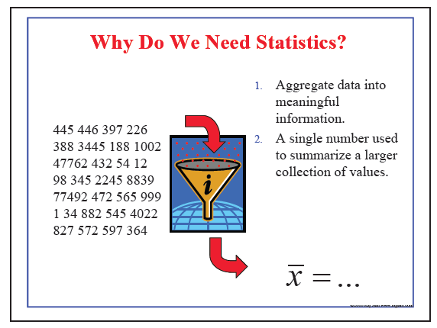
Statistics :

Slide 3
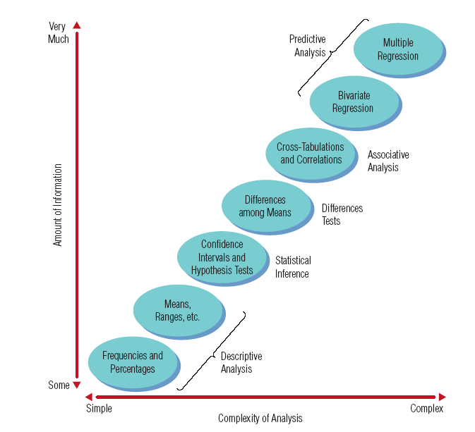
Types of Statistical Analyses Used in Marketing Research

Slide 4
Types of Statistical Analyses Used in Marketing Research
Descriptive analysis: used to describe the data set
Inferential analysis: used to generate conclusions about the population’s characteristics based on the sample data
Differences analysis: used to compare the mean of the responses of one group to that of another group
Associative analysis: determines the strength and direction of relationships between two or more variables
Predictive analysis: allows one to make forecasts for future events

Slide 5
Understanding Data Via Descriptive Analysis
Two sets of descriptive measures:
Measures of central tendency: used to report a single piece of information that describes the most typical response to a question
Measures of variability: used to reveal the typical difference between the values in a set of values

Slide 6
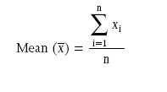
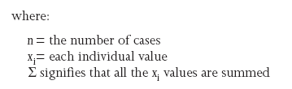
Understanding Data Via Descriptive Analysis
Measures of Central Tendency:
Mode: the value in a string of numbers that occurs most often
Median: the value whose occurrence lies in the middle of a set of ordered values
Mean: sometimes referred to as the “arithmetic mean”; the average value characterizing a set of numbers

Slide 7
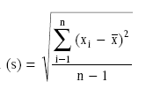
Understanding Data Via Descriptive Analysis
Measures of Variability:
Frequency distribution reveals the number (percent) of occurrences of each number or set of numbers
Range identifies the maximum and minimum values in a set of numbers
Standard deviation indicates the degree of variation in a way that can be translated into a bell-shaped curve distribution

Slide 8
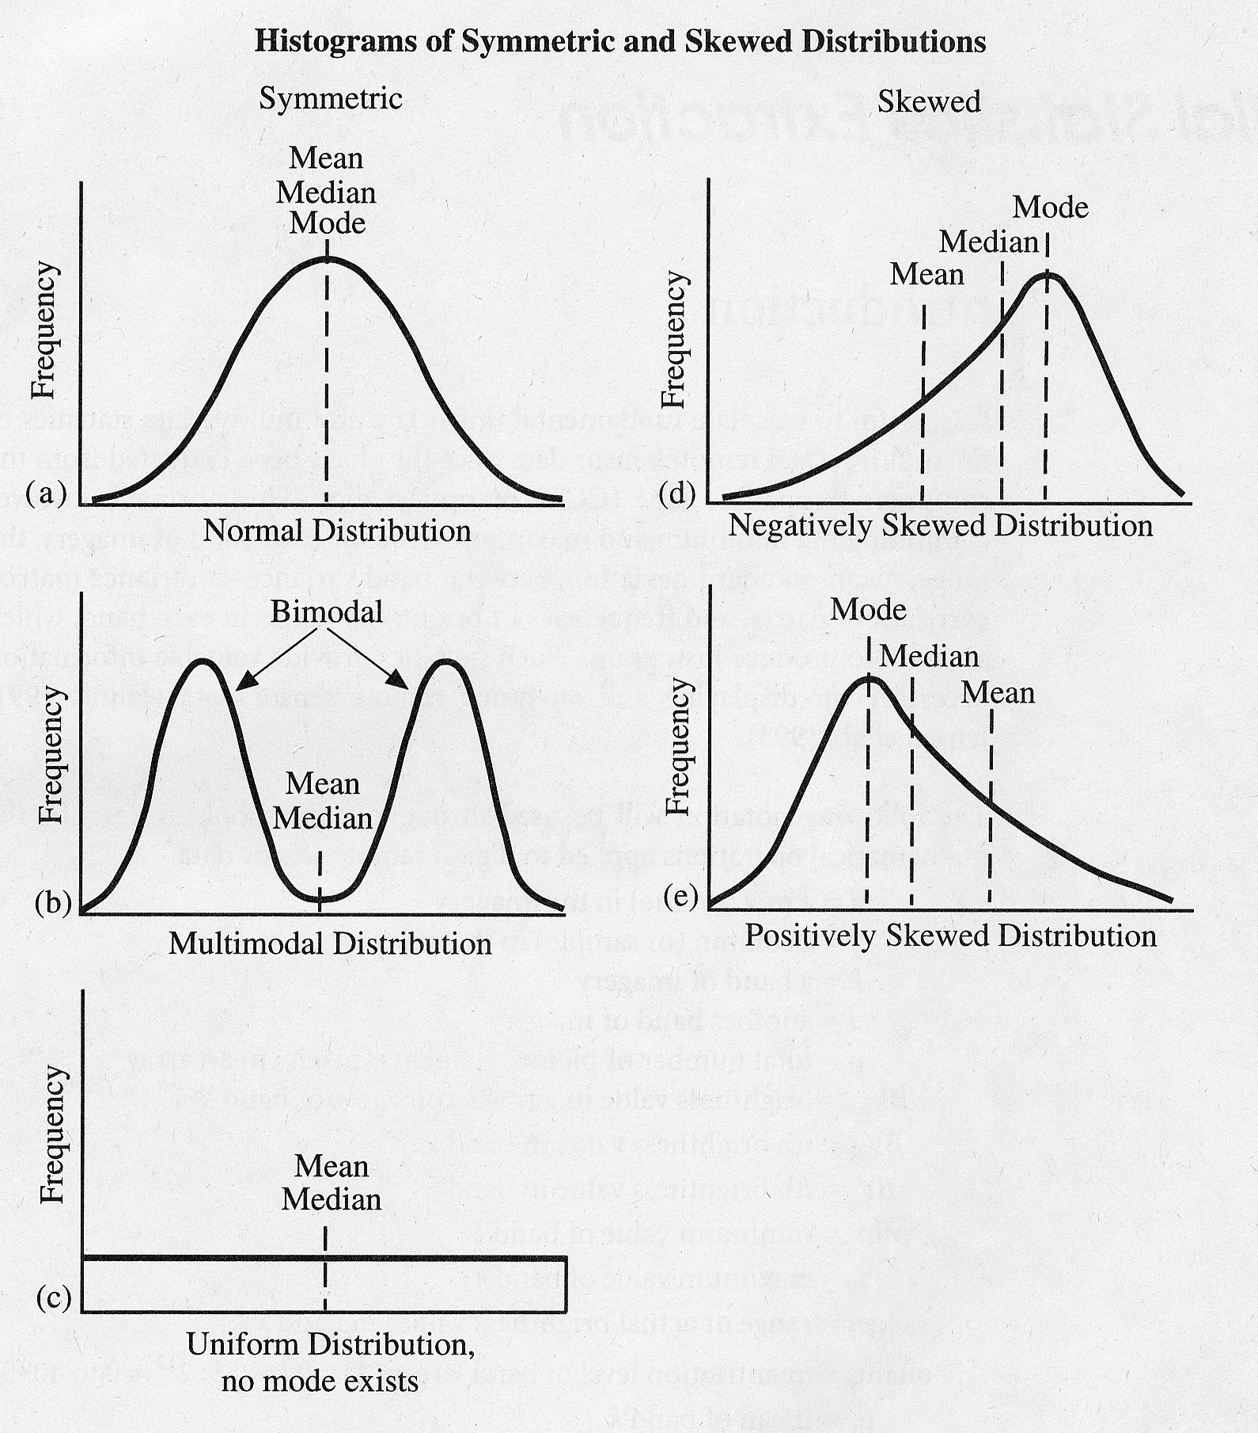
Understanding Data Via Descriptive Analysis
many statistical tests assume
values are normally distributed
not always the case!
examine data prior
to processing
from: Jensen, 1996

Slide 9
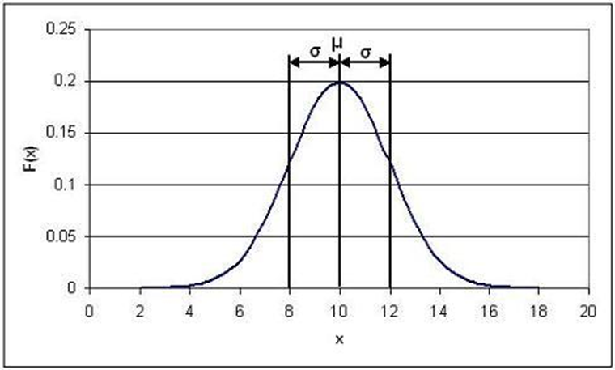
Normal distribution
Infinite members of group: population
Characterize population by taking samples
The larger the number of samples, the closer the distribution becomes to normal
Equation of normal distribution:

Slide 10
Normal distribution
Estimate of mean value of population = μ
Estimate of mean value of samples =
Mean =

Slide 11
Normal distribution
Degree of scatter (measure of central tendency) of population is quantified by calculating the standard deviation
Std. dev. of population = σ
Std. dev. of sample = s

Slide 12
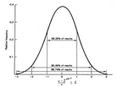
Standard deviation and the normal distribution
Standard deviation defines the shape of the normal distribution (particularly width)
Larger std. dev. means more scatter about the mean, worse precision.
Smaller std. dev. means less scatter about the mean, better precision.

Slide 13
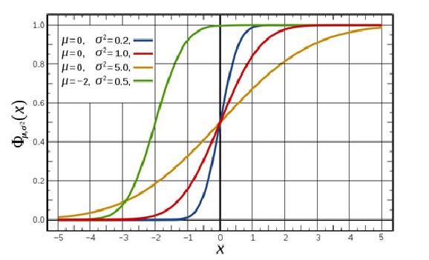
Cumulative Distribution function
The cumulative distribution function () describes probabilities for a random variable to fall in the intervals of the form.
It is the ., the area under the normal distribution (with known mean , and the standard) from negative infinity to x, the mean, and the standard deviation.
The complement of the standard normal cdf, Q(x)=1- Φ(x), is referred to as the Q-function, especially in engineering texts. This represents the tail probability of the Gaussian distribution that is the probability that a standard normal random variable X is greater than the number x.

Slide 14
Cumulative Distribution function- Example

Slide 15
Standard deviation and the normal distribution
There is a well-defined relationship between the std. dev. of a population and the normal distribution of the population:
μ ± 1σ encompasses 68.3 % of measurements
μ ± 2σ encompasses 95.5% of measurements
μ ± 3σ encompasses 99.7% of measurements
(May also consider these percentages of area under the curve)

Slide 16
Skewness and Kurtosis

Slide 17

Skewness and Kurtosis
The histogram can give you a general idea of the shape, but two numerical measures of shape give a more precise evaluation: skewness tells you the amount and direction of skew (departure from horizontal symmetry), and kurtosis tells you how tall and sharp the central peak is, relative to a standard bell curve
Measure of Skewness
A normal distribution has skewness and kurtosis of 0, so if your distribution is close to those values then it is probably close to normal.
Rule of thumb is : If the skewness is greater than 1.0 (or less than -1.0), the skewness is substantial and the distribution is far from symmetrical.

Slide 18
Kurtosis
Kurtosis quantifies whether the shape of the data distribution matches the Gaussian distribution.
A Gaussian distribution has a kurtosis of 0.
A flatter distribution has a negative kurtosis,
A distribution more peaked than a Gaussian distribution has a positive kurtosis
Kurtosis has no units
Sometimes Kurtosos is also referred as the ‘excess kurtosis’ since the expected kurtosis for a Gaussian distribution is 0.0. With this definition, a Gaussian distribution is expected to have a kurtosis of 3.0

Slide 19
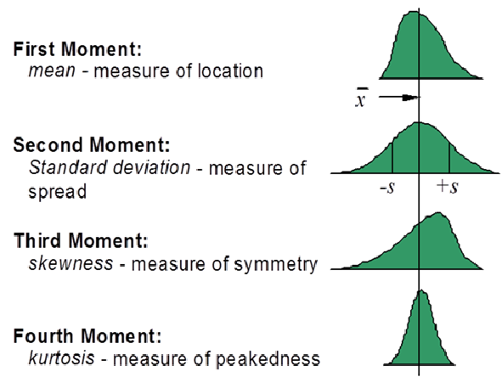

Slide 20
Regression Analysis
Regression analysis is the ART and SCIENCE of fitting straight lines to patterns of data.
If Y denotes the dependent variable, and X1, …, Xk, are the independent variables, then the assumption is that the value of Y at time t (or row t) in the data sample is determined by the linear equation.
where the betas are constants and the epsilons are independent and identically distributed (i.i.d.) normal random variables with mean zero (the “noise” in the system).
β0 is the so-called intercept of the model—the expected value of Y when all the X’s are zero—and
βi is the coefficient (multiplier) of the variable Xi. The betas together with the mean and standard deviation of the epsilons are the parameters

Slide 21
Linear Regression
The expected value of Y is a linear function of the X variables. This means:
if Xi changes by an amount ΔXi, holding other variables fixed, then the expected value of Y changes by a proportional amount βiΔXi, for some constant βi (which in general could be a positive or negative number).
The value of βi is always the same, regardless of values of the other X’s.
The total effect of the X’s on the expected value of Y is the sum of their separate effects.
The unexplained variations of Y are independent random variables.
They all have the same variance (“homoscedasticity”).
They are normally distributed.
No model is perfect—these assumptions will never be exactly satisfied by real-world messy data—but you hope that they are not badly wrong.

Slide 22
Linear Model
The regression model makes very strong assumptions about the WAY in which Y depends on the X’s, namely that the causal or predictive effects of the X’s with respect to Y are linear and additive and non-interactive and that any variations in Y that are not explained by the X’s are statistically independent of each other and identically normally distributed under all conditions.
The ART of regression modelling is to (most importantly!) collect data that is relevant and informative with respect to your decision or inference problem, and then define your variables and construct your model in such a way that the assumptions listed above are plausible, at least as a first-order approximation to what is really happening.

Slide 23
Application
Selection and Placement During the World Wars
Technology helped the United States and her allies to win the first and second world wars. One usually thinks of the atomic bomb, radar, bombsights, better designed aircraft, etc when this statement is made. Less well known were the contributions of psychologists and associated scientists to the development of test and prediction models used for selection and placement of men and women in the armed forces.
During these wars, the United States had thousands of men and women enlisting or being drafted into the military. These individuals differed in their ability to perform physical and intellectual tasks. The problem was one of both selection, who is drafted and who is rejected, and placement, of those selected, who will cook and who will fight. The army that takes its best and brightest men and women and places them in the front lines digging trenches is less likely to win the war than the army who places these men and women in the position of leadership.

Slide 24
Examples
Manufacturing Widgets
A new plant to manufacture widgets is being located in a nearby community. The plant personnel officer advertises the employment opportunity and the next morning has 10,000 people waiting to apply for the 1,000 available jobs. It is important to select the 1,000 people who will make the best employees because training takes time and money and firing is difficult and bad for community relations. In order to provide information to help make the correct decisions, the personnel officer employs a regression model.

Slide 25
PROCEDURE FOR CONSTRUCTION OF A REGRESSION MODEL
The personnel officer of the widget manufacturing company might give all applicants a test and predict the number of widgets made per hour on the basis of the test score.
In order to create a regression model, the personnel officer would first have to give the test to a sample of applicants and hire all of them.
Later, when the number of widgets made per hour had stabilized, the personnel officer could create a prediction model to predict the widget production of future applicants.
All future applicants would be given the test and hiring decisions would be based on test performance.

Slide 26
THE LEAST-SQUARES CRITERIA FOR GOODNESS-OF-FIT
In order to develop a measure of how well a model predicts the data, it is valuable to present an analogy of how to evaluate predictions.
Suppose there were two interviewers, Mr. A and Ms. B, who separately interviewed each applicant for the widget manufacturing job for ten minutes. At the end of that time, the interviewer had to make a prediction about how many widgets that applicant would produce two months later.
All of the applicants interviewed were hired, regardless of the predictions, and at the end of the two month's trial period, one interviewer, the best one, was to be retained and promoted, the other was to be fired. The purpose of the following is to develop a measure of goodness-of-fit, or, how well the interviewer predicted.

Slide 27
GOODNESS-OF-FIT
The notational scheme for the table is as follows:
Y_{i} is the observed or actual number of widgets made per hour
Y'_{i} is the predicted number of widgets
Suppose the data for the five applicants were as follows:
 | Interviewer
Observed | Mr. A | Ms. B
Y_{i} | Y'_{i} | Y'_{i}
23 | 38 | 21
18 | 34 | 15
35 | 16 | 32
10 | 10 | 8
27 | 14 | 23

Slide 28
GOODNESS-OF-FIT
The first step is to find how much each interviewer missed the predicted value for each applicant. This is done by finding the difference between the predicted and observed values for each applicant for each interviewer.
These differences are called residuals.
 | Interviewer
Observed | Mr. A | Ms . B | Mr. A | Ms. B
Y_{i} | Y'_{i} | Y'_{i} | Y_{i} - Y'_{i} | Y_{i} - Y'_{i}
23 | 38 | 21 | -15 | 2
18 | 34 | 15 | -16 | 3
35 | 16 | 32 | 19 | 3
10 | 10 | 8 | 0 | 2
27 | 14 | 23 | 13 | 4
 |  |  | 1 | 14

Slide 29
GOODNESS-OF-FIT
If the column of differences between the observed and predicted is summed, then it would appear that interviewer A is the better at prediction, because he had a smaller sum of deviations, 1, than interviewer B, with a sum of 14.
This goes against common sense.
In this case large positive deviations cancel out large negative deviations, leaving what appears as an almost perfect prediction for interviewer A, but that is obviously not the case..
To avoid this problem procedure is ignore the signs of the differences and then sum, that is, take the sum of the absolute values. This would work, but for mathematical reasons the sign is eliminated by squaring the differences.

Slide 30

GOODNESS-OF-FIT
 | Interviewer
Obs | Mr. A | Ms . B | Mr. A | Ms. B | Mr. A | Ms. B
Y_{i} | Y'_{i} | Y'_{i} | Y_{i} - Y'_{i} | Y_{i} - Y'_{i} | (Y_{i} - Y'_{i})² | (Y_{i} - Y'_{i})²
23 | 38 | 21 | -15 | 2 | 225 | 4
18 | 34 | 15 | -16 | 3 | 256 | 9
35 | 16 | 32 | 19 | 3 | 361 | 9
10 | 10 | 8 | 0 | 2 | 0 | 4
27 | 14 | 23 | 13 | 4 | 169 | 16
 |  |  | 1 | 14 | 1011 | 42
Summing the squared differences yields the desired measure of goodness-of-fit. In this case the smaller the number, the closer the predicted to the observed values. This is expressed in the following mathematical equation.

Slide 31
THE REGRESSION MODEL
The situation using the regression model is analogous to that of the interviewers, except instead of using interviewers, predictions are made by performing a linear transformation of the predictor variable. Rather than interviewers in the above example, the predicted value would be obtained by a linear transformation of the score. The prediction takes the form
where a and b are parameters in the regression model.

Slide 32
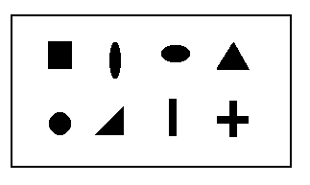
THE REGRESSION MODEL
Suppose that, rather than being interviewed each applicant took a form-board test. A form-board is a board with holes cut out in various shapes: square, round triangular, etc. The goal is to put the right pegs in the right holes as fast as possible. The saying "square peg in a round hole" came from this test, as the test has been around for a long time. The score for the test is the number of seconds it takes to complete putting all the pegs in the right holes.
The data was collected as follows:
Test Score | Widgets/hr
X_{i} | Y_{i}
13 | 23
20 | 18
10 | 35
33 | 10
15 | 27

Slide 33
THE REGRESSION MODEL
Because the two parameters of the regression model, a and b, can take on any real value, there are an infinite number of possible models, analogous to having an infinite number of possible interviewers. The goal of regression is to select the parameters of the model so that the least-squares criterion is met.
For the first model, let a=10 and b=1 attempting to predict the first score perfectly. In this case the regression model becomes
Form-Board | Widgets/hr |  | Residuals | Squared Residuals
Observed | Observed | Predicted
X_{i} | Y_{i} | Y'_{i}=a+bX_{i} | (Y_{i}-Y'_{i}) | (Y_{i}-Y'_{i})²
13 | 23 | 23 | 0 | 0
20 | 18 | 30 | -12 | 144
10 | 35 | 20 | 15 | 225
33 | 10 | 43 | -33 | 1089
15 | 27 | 25 | 2 | 4
 |  |  | (Y_{i}-Y'_{i})² | 1462
Because it is desired that the model work for all applicants, some other values for the parameters must be tried.

Slide 34
THE REGRESSION MODEL
The selections of the parameters for the second model is based on the observation that the longer it takes to put the form board together, the fewer the number of widgets made.
When the tendency is for one variable to increase while the other decreases, the relationship between the variables is said to be inverse. The mathematician knows that in order to model an inverse relationship, a negative value of b must be used in the regression model.
Lets try a=36 and b=-1
Xi | Yi | Y'i=a+bXi | (Yi-Y'i) | (Yi-Y'i)2
13 | 23 | 23 | 0 | 0
20 | 18 | 16 | 2 | 4
10 | 35 | 26 | 9 | 81
33 | 10 | 3 | 7 | 49
15 | 27 | 21 | 6 | 36
 |  |  | (Yi-Y'i)2 | 170

Slide 35
THE REGRESSION MODEL
Fairly large deviations are noted for the third applicant, which might be reduced by increasing the value of the additive component of the transformation, a. Thus a model with a=41 and b=-1 will now be tried.
X_{i} | Y_{i} | Y'_{i}=a+bX_{i} | (Y_{i}-Y'_{i}) | (Y_{i}-Y'_{i})²
13 | 23 | 28 | -5 | 25
20 | 18 | 21 | -3 | 19
10 | 35 | 31 | 4 | 16
33 | 10 | 8 | 2 | 4
15 | 27 | 26 | 1 | 1
 |  |  | (Y_{i}-Y'_{i})² | 55
It is still a better solution than previous
"When do we know when to stop?"

Slide 36
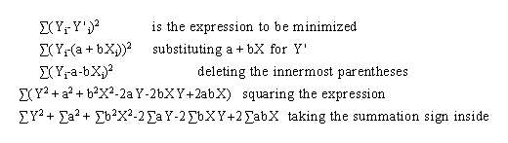

THE REGRESSION MODEL
The mathematical problem can be stated as follows:
"The values of a and b in the linear model Y'_{i} = a + b X_{i} are to be found which minimize the algebraic expression

Slide 37
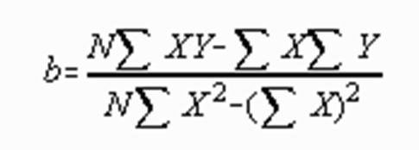
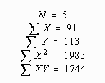
THE REGRESSION MODEL
 | X_{i} | Y_{i} | X_{i}² | X_{i}Y_{i}
 | 13 | 23 | 169 | 299
 | 20 | 18 | 400 | 360
 | 10 | 35 | 100 | 350
 | 33 | 10 | 1089 | 330
 | 15 | 27 | 225 | 405
SUM | 91 | 113 | 1983 | 1744

Slide 38
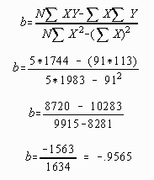
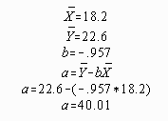
GOODNESS-OF-FIT
This procedure results in an "optimal" model. That is, no other values of a and b will yield a smaller sum of squared deviations.

Slide 39
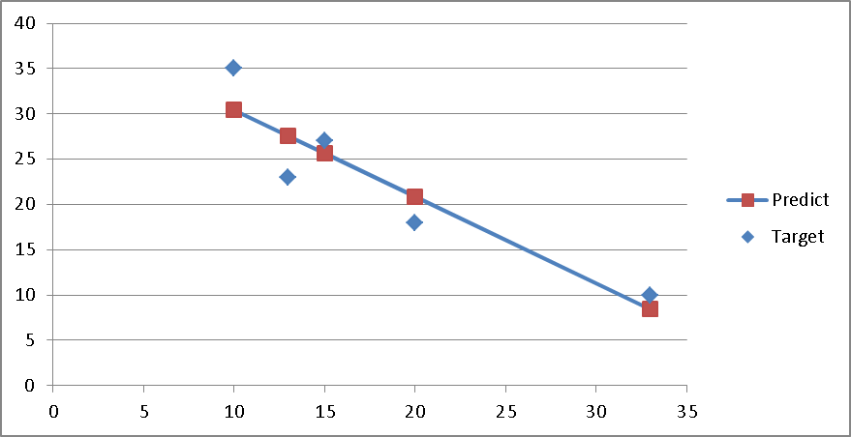
THE REGRESSION MODEL

Slide 40

THE STANDARD ERROR OF ESTIMATE
The standard error of estimate is a measure of error in prediction
The standard error of estimate is a standard deviation type of measure. Note the similarity of the definitional formula of the standard deviation of Y to the definitional formula for the standard error of measurement.
Two differences appear.
First, the standard error of measurement divides the sum of squared deviations by N-2, rather than N-1.
Second, the standard error of measurement finds the sum of squared differences around a predicted value of Y, rather than the mean.

Slide 41
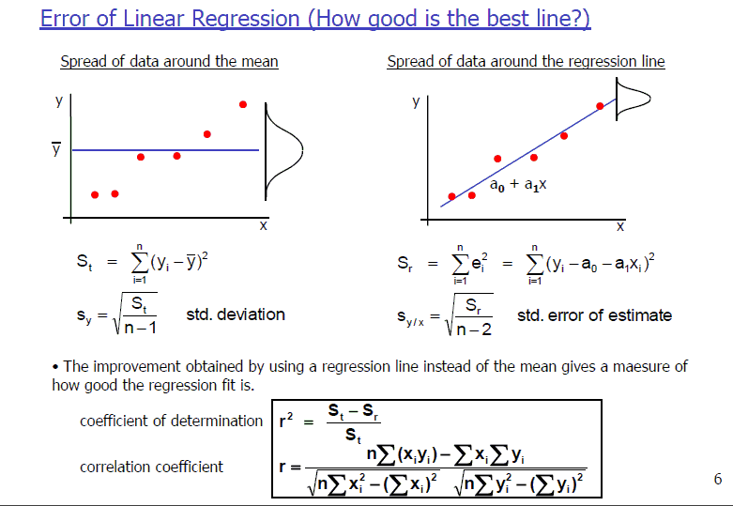
INTERVAL ESTIMATES

Slide 42
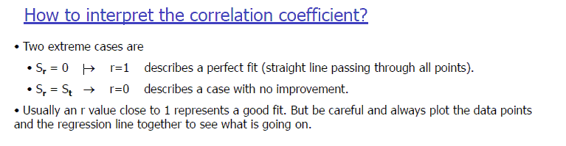

Slide 43
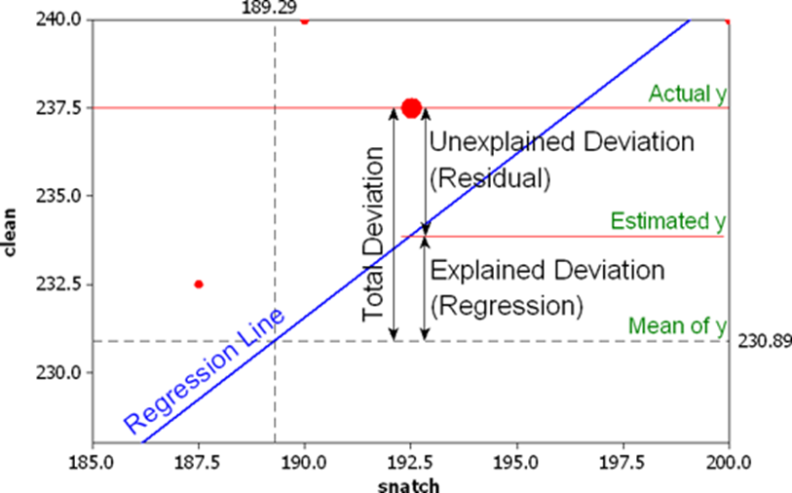
Variance/Deviation Analysis

Slide 44
Confidence Intervals
What are Confidence Intervals?
A confidence interval is a range of values, derived from sample statistics, that is likely to contain the value of an unknown population parameter. Because of their random nature, it is unlikely that two samples from a given population will yield identical confidence intervals. But if you repeated your sample many times, a certain percentage of the resulting confidence intervals would contain the unknown population parameter. The percentage of these confidence intervals that contain the parameter is the confidence level of the interval
Most frequently, you’ll use confidence intervals to bound the mean or standard deviation, but you can also obtain them for regression coefficients, for the differences between populations etc.
The confidence interval (CI) of a point estimate describes the precision of the estimate
The CI represents a range of values on either side of the estimate
The narrower the CI, the more precise the point estimate.
Notes:
How do we know whether an odds ratio of 19.6 as in the preceding example is meaningful in our investigation? We can start by calculating the confidence interval (CI) around the odds ratio. When we calculate an estimate (like risk or odds), or a measure of association (like a risk ratio or an odds ratio), that number (in this case 19.6) is called a point estimate. The confidence interval of a point estimate describes the precision of the estimate. It represents a range of values on either side of the estimate. The narrower the confidence interval, the more precise the point estimate. (3) Your point estimate will usually be the middle value of your confidence interval.

Slide 45
Confidence Intervals - Example
Suppose that you randomly sample light bulbs and measure the burn time. Lets suppose the 95% confidence interval is 1230 – 1265 hours.
The confidence interval indicates that you can be 95% confident that the mean for the entire population of light bulbs falls within this range.
Confidence intervals only assess sampling error in relation to the parameter of interest. (Sampling error is simply the error inherent when trying to estimate the characteristic of an entire population from a sample.)
Notes:
An analogy can help explain the confidence interval. Say we have a large bag of 500 red, green, and blue marbles. We are interested in knowing the percentage of green marbles, but we do not have the time to count every marble. So we shake up the bag and select 50 marbles to give us an idea, or an estimate, of the percentage of green marbles in the bag. In our sample of 50 marbles, we find 15 green marbles, 10 red marbles, and 25 blue marbles.

Slide 46
Confidence Intervals - cont
As you increase the sample size, the sampling error decreases and the intervals become narrower. If you could increase the sample size to equal the population, there would be no sampling error. In this case, the confidence interval would have a width of zero and be equal to the true population parameter.
In the light bulb example, we know that the mean is likely to fall within the range, but the 95% confidence interval does not predict that 95% of future observations will fall within the range.
Notes:
Based on this sample, we can conclude that 30% (15 out of 50) of the marbles in the bag are green. In this example, 30% is the point estimate. Do we feel confident in stating that 30% of the marbles are green? We might have some uncertainty about this statement, since there is a chance that the actual percent of green marbles in the entire bag is higher or lower than 30%. In other words, our sample of 50 marbles may not accurately reflect the actual distribution of marbles in the whole bag of 500 marbles. One way to determine the degree of our uncertainty is to calculate a confidence interval.

Slide 47
Prediction Intervals
What Are Prediction Intervals?
A prediction interval is a type of confidence interval that you can use with predictions from linear and nonlinear models..
There are two types of prediction intervals that use predictor values entered into the model equation
1. Confidence interval of the prediction
A confidence interval of the prediction is a range that is likely to contain the mean response given specified settings of the predictors in your model. Just like the regular confidence intervals, the confidence interval of the prediction presents a range for the mean rather than the distribution of individual data points.
Notes:
So how do you calculate a confidence interval? It’s certainly possible to do so by hand. Most of the time, however, we use statistical programs such as Epi Info, SAS, STATA, SPSS, or Episheet to do the calculations. The default is usually a 95% confidence interval, but this can be adjusted to 90%, 99%, or any other level depending on the desired level of precision.
For those interested in calculating confidence intervals by hand, the following resource may be helpful:
Giesecke, J. Modern Infectious Disease Epidemiology. 2nd Ed. London: Arnold Publishing; 2002.

Slide 48
Confidence Interval of the Prediction
Going back to our light bulb example, suppose we design an experiment to test how different production methods (Slow or Quick) and filament materials (A or B) affect the burn time. After we fit a model, we can predict the response for specific settings.
We want to predict the mean burn time for bulbs that are produced with the Quick method and filament type A.
Lets say a confidence interval of the prediction of 1400 – 1450 hours.
We can be 95% confident that this range includes the mean burn time for light bulbs manufactured using these settings.
Notes:
The most commonly used confidence interval is the 95% interval. When we use a 95% confidence interval, we conclude that our estimated range has a 95% chance of containing the true population value (e.g., the true percentage of green marbles in our bag). Let’s assume that the 95% confidence interval is 17-43%.
How do we interpret this? Well, we estimated that 30% of the marbles are green, and the confidence interval tells us that the true percentage of green marbles in the bag is most likely between 17 and 43%. However, there is a 5% chance that this range (17-43%) does not contain the true percentage of green marbles.

Slide 49
Prediction interval
A prediction interval is a range that is likely to contain the response value of a single new observation given specified settings of the predictors in your model.
We’ll use the same settings as above, and lets suppose a prediction interval is f 1350 – 1500 hours.
We can be 95% confident that this range includes the burn time of the NEXT LIGHT BULB produced with these settings.
The prediction interval is always wider than the corresponding confidence interval of the prediction because of the added uncertainty involved in predicting a single response versus the mean response.
Notes:
In epidemiology we are usually comfortable with this 5% chance of error, which is why we commonly use the 95% confidence interval. However, if we want less chance of error, we might calculate a 99% confidence interval, which has only a 1% chance of error. This is a trade-off, since with a 99% confidence interval the estimated range will be wider than with a 95% confidence interval. In fact, with a 99% confidence interval, our estimate of the percentage of green marbles is 13-47%. That’s a pretty wide range! On the other hand, if we were willing to accept a 10% chance of error, we can calculate a 90% confidence interval (and in this case, the percentage of green marbles will be 19-41%).

Slide 50
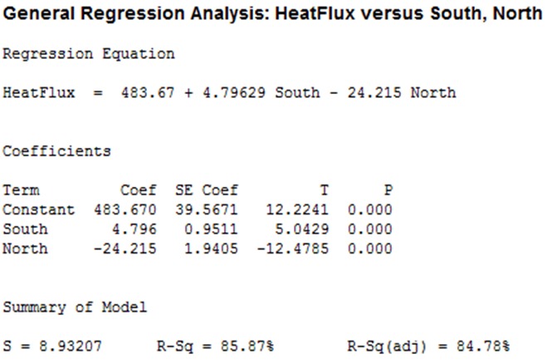
PI-Application
As part of a solar energy test, researchers measured the total heat flux. They found that heat flux can be predicted by the position of the focal points in the south and north directions. We’ll use the General Regression results to correctly position the focal points.
Notes:
Ideally, we would like a very narrow confidence interval, which would indicate that our estimate is very precise. One way to get a more precise estimate is to take a larger sample. If we had taken 100 marbles (instead of 50) from our bag and found 30 green marbles, the point estimate would still be 30%, but the 95% confidence interval would be a range of 21-39% (instead of our original range of 17-43%). If we had sampled 200 marbles and found 60 green marbles, the point estimate would be 30%, and with a 95% confidence interval the range would be 24-36%. You can see that the confidence interval becomes narrower as the sample size increases.

Slide 51
PI_Application cont..
We want to arrange the focal points so that we can be 95% confident that the heat flux will be less than 250 in order to reduce heat damage. However, we don’t want to go lower than necessary because the system would capture less sunlight.
To protect against variability around the average prediction, we’ll need settings that produce an average heat flux prediction that is somewhat less than 250. But how much lower should it be?

Slide 52
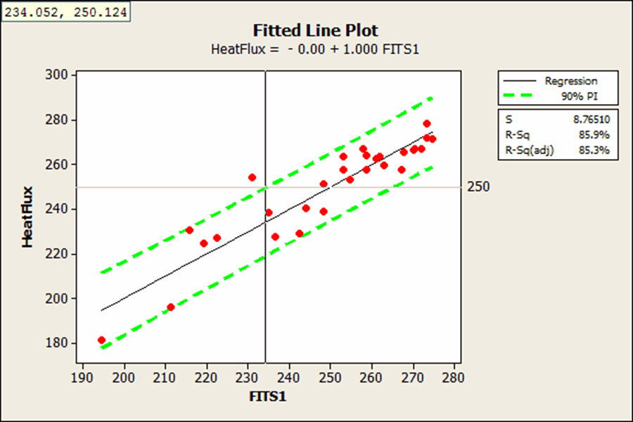
PI_application cont..
With the crosshairs, we see that the 95% upper bound crosses the reference line at a fitted value of 234.052. This tells us that we’ll need a fitted value near 234 to be 95% confident that the next measurement of heat flux will be less than 250.
This graph doesn’t tell us the specific settings for the focal points, but we have an idea of what our target prediction should be.

Slide 53

The Pearson Correlation Coefficient
The Pearson correlation coefficient measures the strength and direction of a linear relationship between the x and y variables. Like other numerical measures, the population correlation coefficient is the Greek letter rho, ρ, and the sample correlation
S_{xx} = Sum of Squares of the X data (same as SS_{x})
S_{yy} = Sum of Squares of the Y data (same as SS_{y})
S_{xy} = Sum of Squares of the (X,Y) pairs (same as SS_{xy})
S_{x} = Standard deviation of the X data
S_{y} = Standard deviation of the Y data
S_{xy} = Standard deviation of the (X,Y) pairs

Slide 54
Properties of Pearson's Correlation
The value of r does not depend upon the units of measurement. For example, if X is the weight in pounds and Y is the height in inches of a person, then the correlation between X and Y would be the same if we measured X in kilograms and Y in centimetres.
The value of r does not depend upon which variable is labelled X and which variable is labelled Y. In other words, the correlation of X and Y = correlation of Y and X.
−1 ≤ r ≤ +1. A positive value of r means a positive linear relationship, a negative value of r means a negative linear relationship.
r = +1 is a perfect positive linear relationship and r = −1 is a perfect negative linear relationship. This is extremely rare.

Slide 55
Strength of Correlation
We can generally define the strength of correlation as follows: (This is only a general guide!)
Strong: |r| ≥ 0.8
Moderate: 0.5 ≤ |r| < 0.8
Weak: |r| < 0.5
NOTE: Since correlation measures only a linear relationship, to have r close to or equal to zero does not mean that there is no relationship between x and y.

Slide 56
Causation and Confounding
We must be very careful in interpreting correlation coefficients. Just because two variables are highly correlated does not mean that one variable causes the other to change. In statistical terms, we say that correlation does not imply causation. There are many good examples of correlated variables which are nonsensical (not causal) when interpreted in terms of causation.
Ice cream sales and the number of shark attacks on swimmers are positively correlated.
Skirt lengths and stock prices are positively correlated (as stock prices go up, skirt lengths get shorter).
The number of cavities in elementary school children and vocabulary size have a strong positive correlation.

Slide 57
Causation
Three types of relationships which can be taken (or mistaken) for causation are:
Causation: Changes in X cause changes in Y. For example, football weekends cause heavier traffic, more food sales, etc.
Common response: Both X and Y respond to changes in some unobserved variable. All three of our examples above are examples of common response.
Ice cream sales and shark attacks both increase during summer.
Skirt lengths and stock prices are both controlled by the general attitude of the country, liberal or conservative.
The number of cavities and children's vocabulary are both related to a child's age.
Confounding: The effect of X on Y is hopelessly mixed up with the effects of other explanatory variables on Y. For example, if we are studying the effects of Tylenol (medicine) on reducing pain, and we give a group of pain-sufferers Tylenol and record how much their pain is reduced, we are confounding the effect of giving them Tylenol with giving them any pill. Many people report a reduction in pain by simply being given a sugar pill (placebo) with no medication in it at all. This is called the placebo effect. To establish causation, a designed experiment must be run.

Slide 58
The Straight Line Regression Model
The model can be stated as:
where
Y is the response variable (also called dependent variable)
X is the predictor (also called independent variable)
alpha & beta are the parameters representing the y-intercept and slope
e is the error (also called random deviation or random noise)
Y = α + β•X is called the population regression line.
Assumptions about Error (e):
e has mean zero and variance for every value of x.
e is normally distributed.
e₁, e₂, e₃,..., e_{n} are independent of one another.

Slide 59
Least Squares Line
Recall the equation of a line from algebra (Y = mX + b) and apply it to the following notation:
Y-hat is the estimated response, E(Y), for a given value of X.
b is called the slope of the line.
a is the y-intercept.
The slope "b" measures the amount Y increases when X increases by one unit. The y-intercept is the value of Y when X = 0.

Slide 60
Least Squares Line
The objective of simple linear regression is to fit a straight line through the points on a scatterplot that best represents all the points. So we want to find a and b such that the line [Y = a + bX] fits the points as well as possible. To do this, we first define what we mean by a "best fit" line. This line, in some sense, is closest to all of the data points simultaneously. In statistics, we define a residual, e_{i}, as the vertical distance between a point and the line,
Since residuals can be positive or negative, we square them to remove the sign. By adding up all of the squared residuals, we get a total measure of how far away from the data our line is. This sum is called the SSresid = Sum of Squared residuals.
Thus, the "best fit" line is defined as the one whose sum of squared residuals is a minimum. This method of finding a line is called least squares.

Slide 61
Coefficient of Determination (R²⁾ A statistic that is widely used to determine how well a regression line fits a set of (X,Y) data pairs is the coefficient of determination (or multiple correlation coefficient), R².
The coefficient of determination represents the percent of variability in Y that can be explained by the variability explained by the linear relationship between X and Y.
In other words, R² explains how much of the variability in the Y's can be explained by the fact that they are related to X. (i.e., how close the points are to the least squares regression line)
In the simple linear regression case, the coefficient of determination is equal to Pearson's correlation coefficient squared; R² = (r)².

Slide 62
Inferences for Regression Parameters
In many situations, a general form of a C% confidence interval for a parameter is:
Point estimate + (critical tabled value) • Standard error(statistic)
Using this method, a confidence interval can be determined for alpha (true Y-intercept) and beta (true slope). We will not discuss the detailed formulas in this class, but rather let the computer software determine its value.
Likewise, we can test the significance of the linear relationship by determining if "0" is a possible value in the confidence interval for the population slope (Beta) or the population correlation (rho).

Slide 63
Estimating Y for a given value of X There are two type of intervals we will consider for estimating Y for a given value of X:
Confidence (Estimation) Interval for the mean response, E(Y).
Prediction Interval for the mean response, E(Y).
NOTE: The prediction interval is wider than the estimation interval because it is an inference about future data where the estimation interval is an inference on the current population the sample data represents.

Slide 64
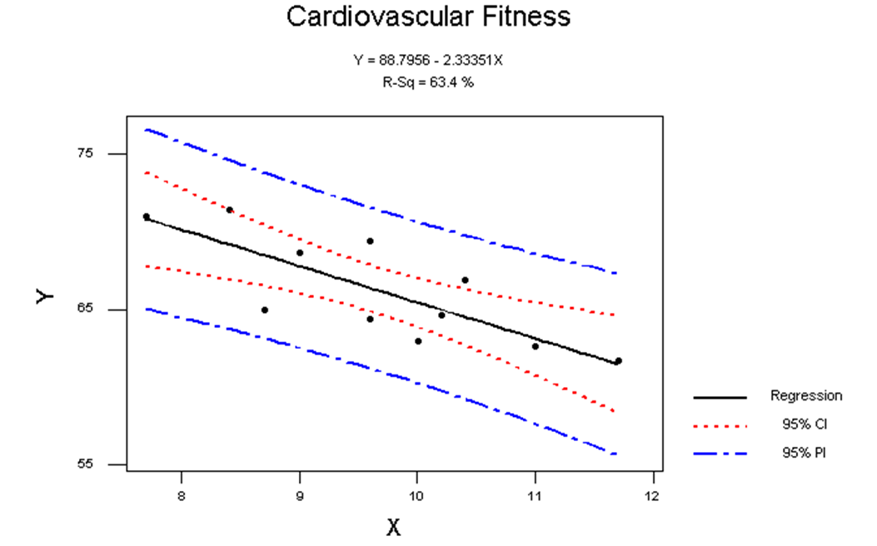
CI and PI

Slide 65
Steps in Linear Regression Analysis
Determine if a possible Linear relationship exists between X and Y. This is done either visually by use of scatterplot or analytically by calculating correlation. If it is clear a non-linear pattern exists, you would not do a Linear Regression analysis, but rather move to a higher order regression analysis. (parabolic, quadratic, cubic, ...etc.)
Calculate the Least-Squares Regression Line. To determine this line, you need the slope and y-intercept.
Determine if the Linear Relationship is statistically significant. This is done through a test of the population slope or test of the population correlation. You can also calculate confidence intervals for the population slope and y-intercept.
Measure the strength of the linear relationship. We've discussed two measures of this type: 1. Correlation (r) and 2. Coefficient of Determination (R₂). Is is also not uncommon to calculate a confidence interval for the population correlation.
Check your model assumptions. This is a very important step to ensure your model is adequate.
Make any desired estimates and predictions. This is done through confidence and prediction intervals of the mean response (Y), for a given value of X.

Slide 66
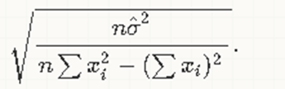
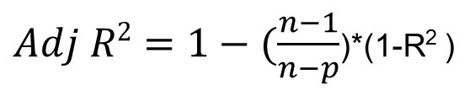
Standard error of Coefficients
The standard error of the estimated slope is
Where σ hat is mean square error
mean square error= (Y-Y(predcted))^2/df)
s = sqrt[ ∑ ((e_i)^2/(n-2)) / (∑ (x_i - xbar)^2) ]
$Adj R2=1−(\frac{n−1}{n−p}$)*(1-R² )

Slide 68

THANK YOU!

